Slide 1
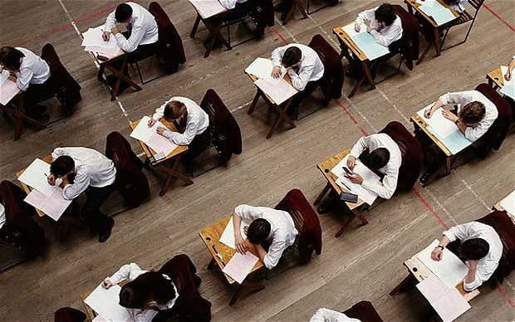
Y11 GCSE Mock Exams Monday 22 November – Friday 3 December

Slide 2
Where are they taking place?
ALL STUDENTS
During the next two weeks Year 11 will be completing their first set of ‘Mock’ GCSE examinations
The vast majority of exams are taking place in the sports hall and the drama studio
There will also be exams in other small rooms – mainly in the SEN department and the far end of C-block
Some areas of the school will be out of bounds when these exams are taking place

Slide 3
Year 11 Mock 1 Timetable
 | Week 1: WC - 22 November
 | Mon | Tues | Wed | Thurs | Fri
AM 9:00 | English Language Paper 1 1h 45min | DT | English Language Paper 2 2hrs 05 mins | Comp Sci / Health and Social | Food / Drama
 | Period 3 + 4 / Lunch
PM 1:30 | Business | Maths Paper 1 (Non-Calculator) 1h 30mins | RP | History | Biology Paper 1 (1h 15mins / 1h 45mins)
 | Week 2: WC - 29 November
 | Mon | Tues | Wed | Thurs | Fri
AM 9:00 | English Literature Paper 2 1h 20mins | French | Maths Paper 2 (Calculator) 1h 30mins | PE / Music | INSET DAY Art / Music
 | Period 3 + 4 / Lunch
PM 1:30 | Spanish | Chemistry Paper 1 (1h 15mins / 1h 45mins) | Geography | Physics Paper 1 (1h 15mins / 1h 45mins) | INSET DAY Art / Music

Slide 4
ALL STUDENTS
Areas out of bounds during break time. And the end of the day.
At the end of each day you will be escorted to collect your bike if it is kept behind C-block.
Out of bounds
Out of bounds

Slide 5
What happens when I am not in an exam?
Y11 ONLY
You attend your usual lesson, and should have revision material with you for exams later that day / week.
Teachers may decide to continue with delivering content that is relevant to your mock exams or let you revise for upcoming mocks. No new content will be taught in lessons
You will not be allowed to leave a lesson to collect revision materials from other teachers. Make sure you have everything you need each day
Some afternoon exams finish after 3pm. You will remain in the exam until it has finished.
Notes:
Put across the message that students are not allowed to leave to collect brothers / sisters etc.

Slide 6
Y11 ONLY

Slide 8
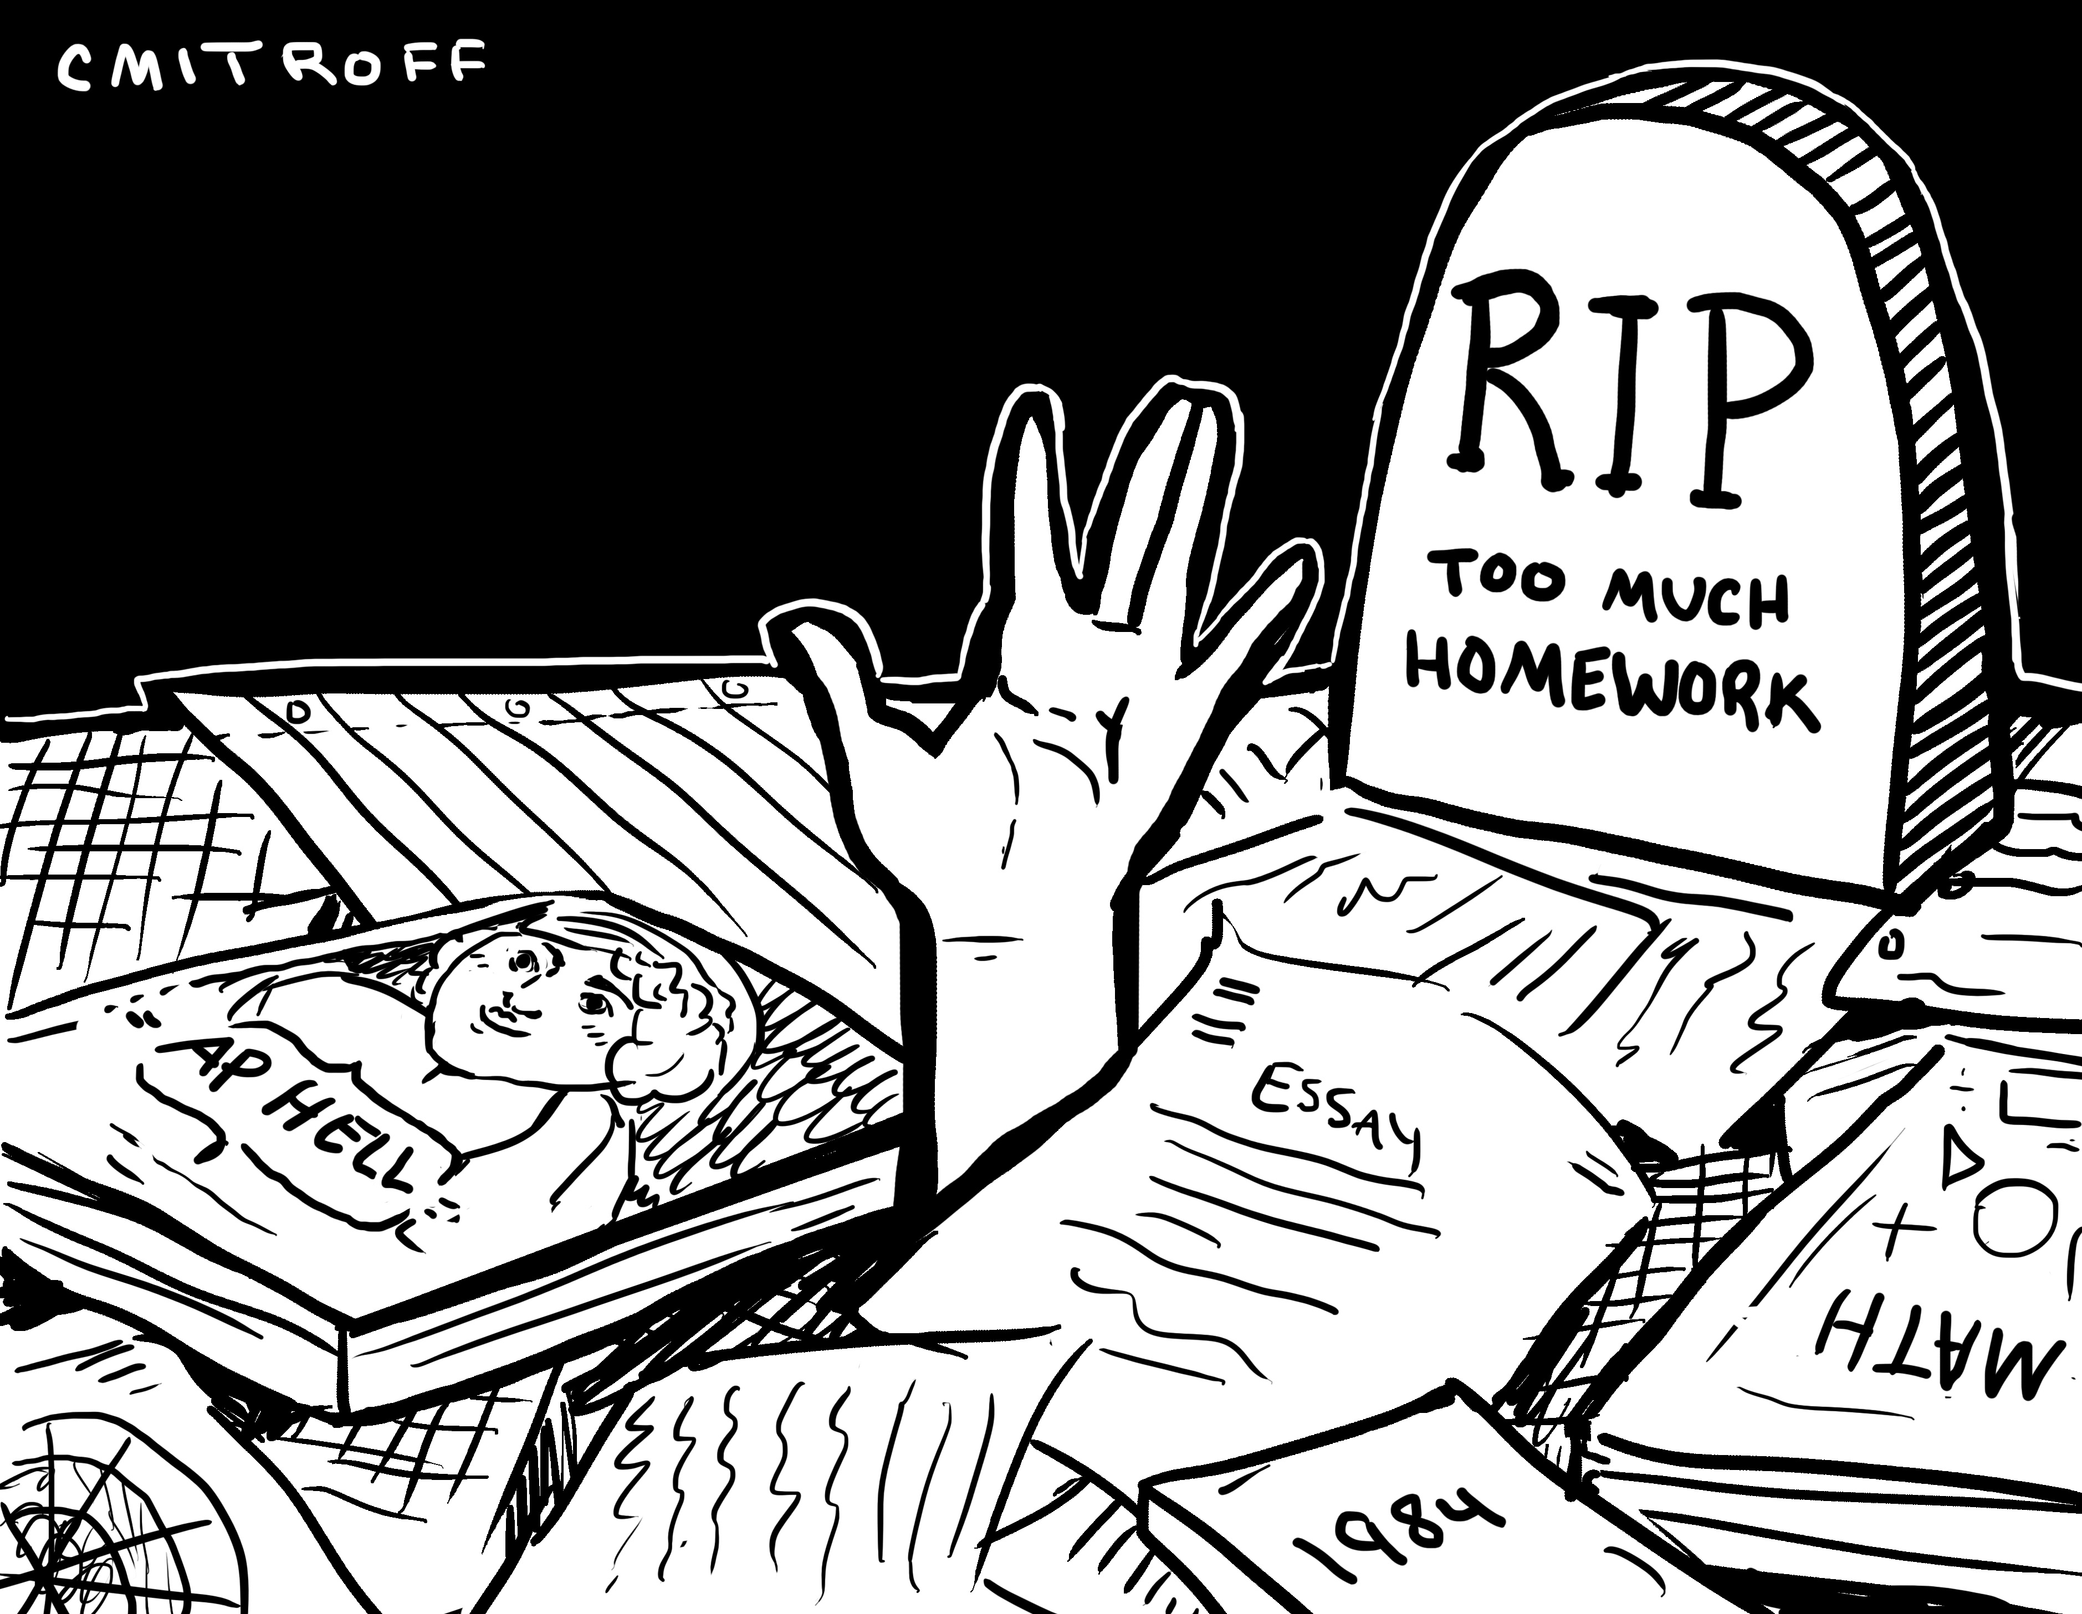
How Do You Feel About Preparing For Exams?
1. I find it difficult to begin revision while we are still covering new content
2. I sleep badly the night before an exam
3. I'm always certain I'm going to fail exams
4. I can't draw up a realistic timetable
5. I can't concentrate on my revision for long enough at a time
6. I seem to forget things
7. Other people seem so confident
8. I can't get down to revision until the last moment
9. I don't think I work hard enough
10. Sometimes I feel like giving up

Slide 9
What Do Exams Require Of You?
1. Organise your knowledge for revision:
sort through your notes - check areas where you are less confident
get an overview of your subject by reading the appropriate sections of your notes or revision guides
read summaries
2. Recall what you have learnt:
memorise information sufficiently
recall under exam conditions
3. Restructure your knowledge in response to a particular question:
know what the examiners require from you
shaping it into the form asked for by the exam

Slide 10
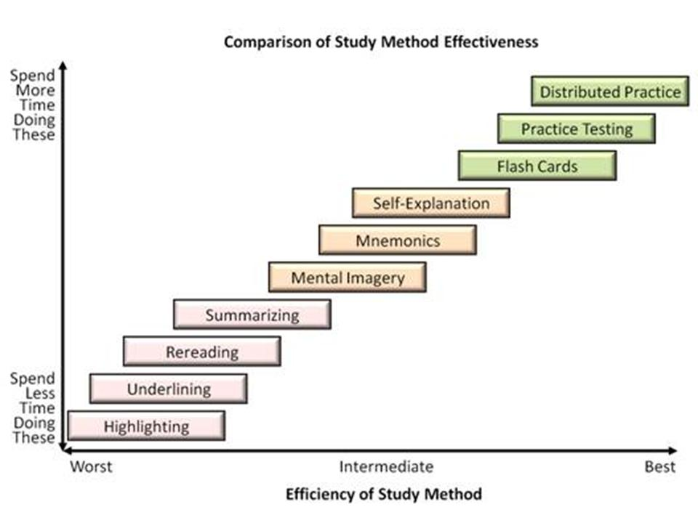

Slide 11
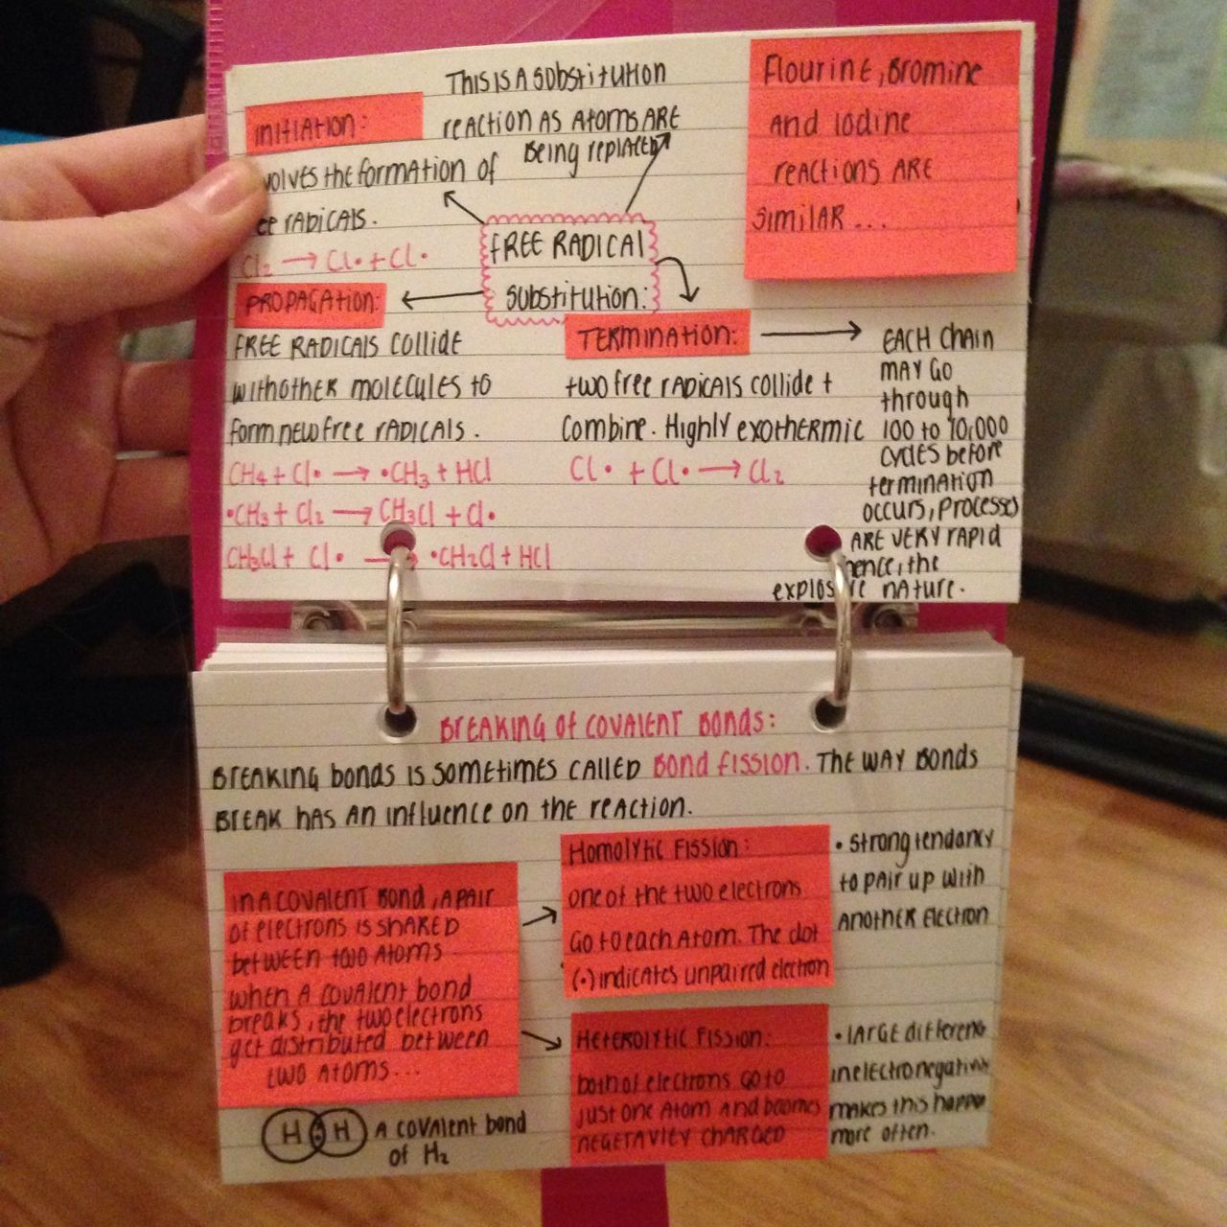
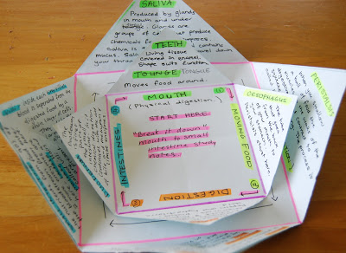
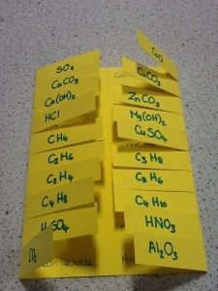
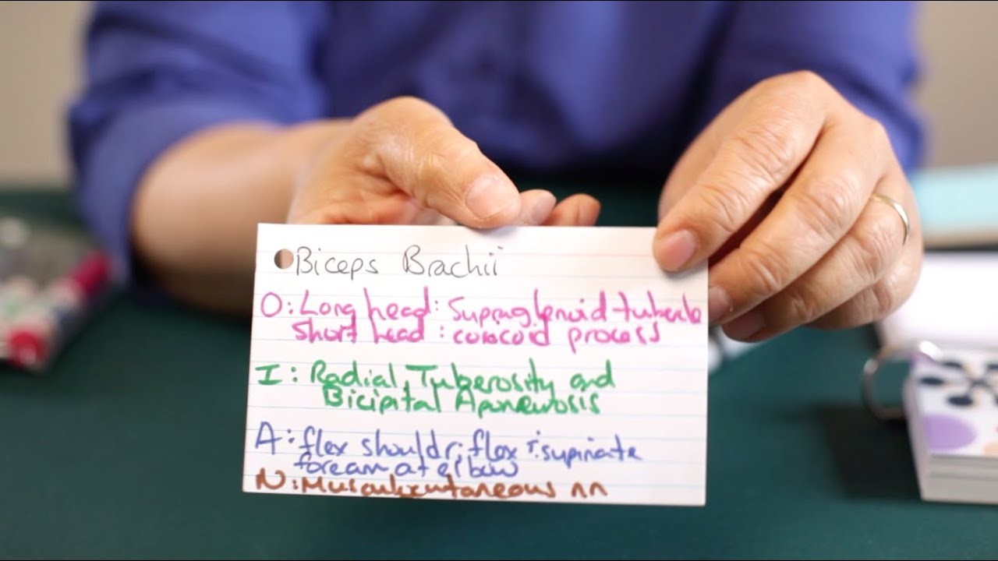
Flash Cards

Slide 12
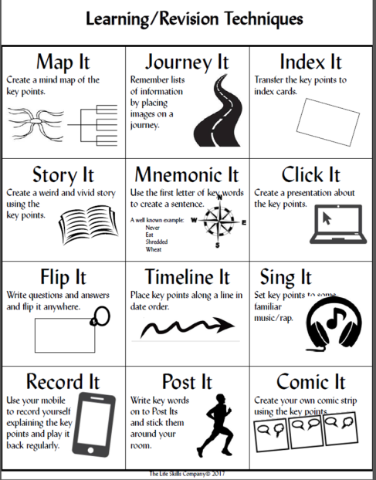

Slide 13
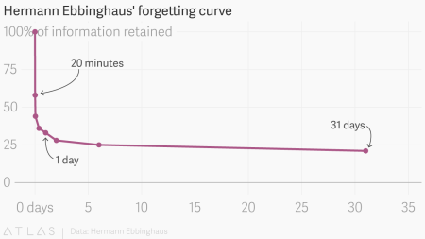
Distributed Practice

Slide 14
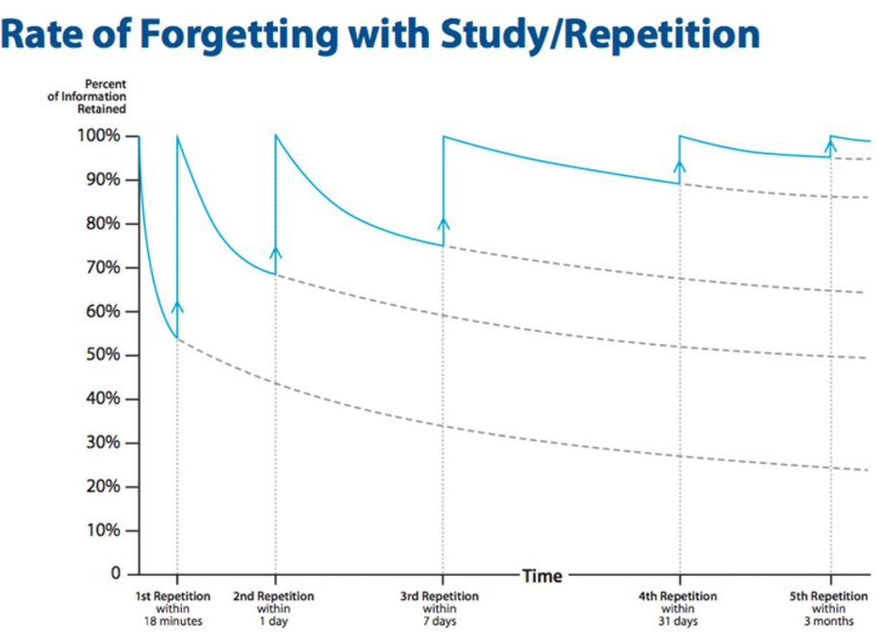

Slide 15
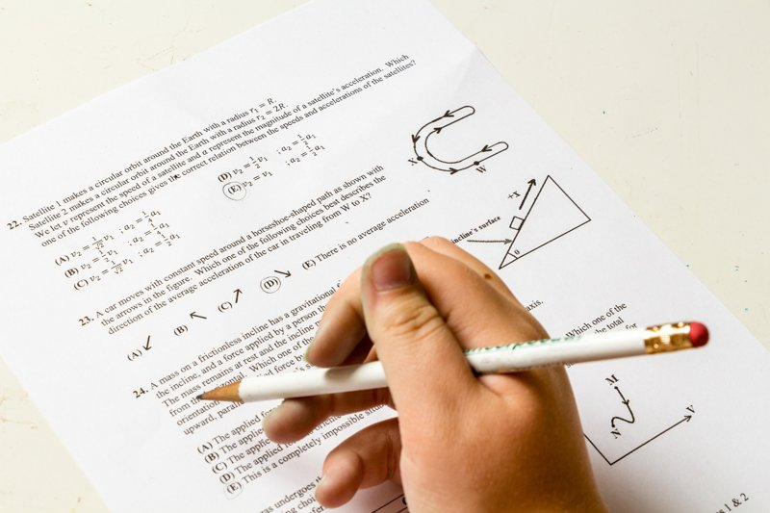
Past Paper Questions
- Answering past paper questions similar to those you will have in your exams is an effective revision technique
- Use mark schemes and examiners reports to discover how best to respond to specific questions

Slide 16
Quick Revision Tips
You can sometimes use very short periods for revision. - Five or ten minutes may be enough to remind yourself of a course overview
Short periods are also useful for revising word lists, dates, or formulas
Carry small revision cards and prompt lists for this purpose
Three or four shorter sessions like this might be more useful than one longer block

