Slide 1
A WARM WELCOME FROM
Your
restaurant provider
at
Bristol Free School

Slide 2
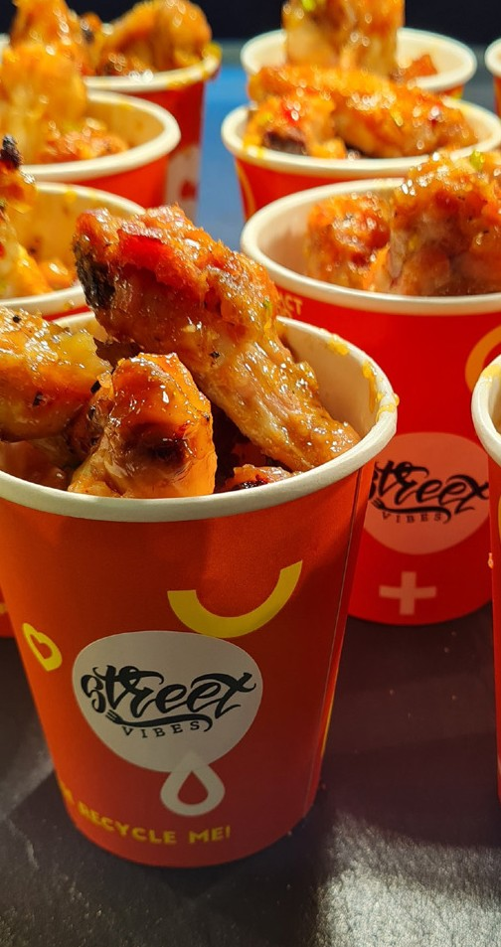
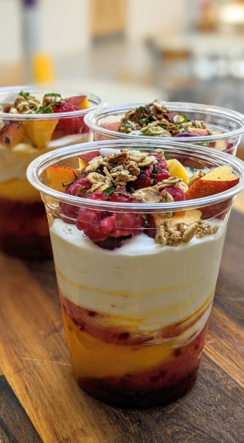
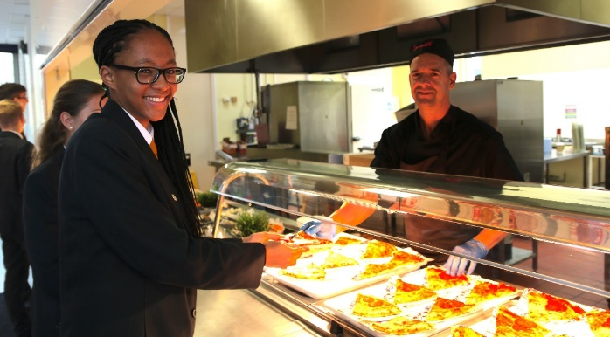
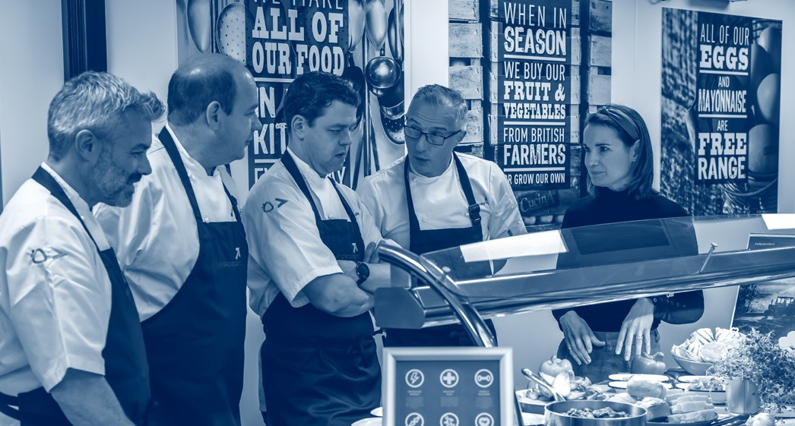
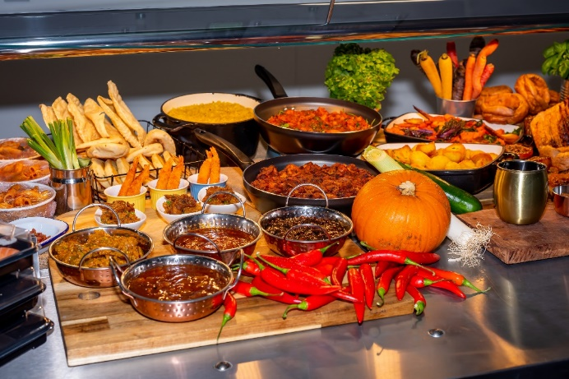
We are delighted to partner with the students, teachers, and staff at Bristol Free School.
Our aim, along with the school, is to provide all students with an exceptional catering experience. Our very talented Executive Chef and the fantastic catering team will be serving exciting menus packed with healthy ingredients, that are full of variety, and with loads of interesting new things to try. It’s important that the food tastes as good as it looks, and we’re sure you won’t be disappointed.
What’s on the menu?
Innovate has long been considered the most inventive school caterer and that’s because we’re very clear about our food. All our dishes are prepared every day using quality, fresh and seasonal ingredients that are responsibly sourced. As well as ensuring the food on the plate is healthy, we want our customers to understand the importance of eating the right foods and help them with their food and nutrition journey. Here’s a taste of what’s to come:
A huge selection of 'grab and go' items including baguettes, paninis, burritos and salads to name a few.
A variety of healthy, tasty main meals prepared fresh every day from carefully selected ingredients. The menu will follow a similar weekly pattern so you know what to expect, providing over 35 choices each day in addition to the ever popular chef specials, themed events and loyalty schemes.
Our Street Vibes range, global street food that tours the world. It’s always changing; from Korean fried chicken, Chinese bao buns, to Greek souvlaki, there’s always something new to try!
A salad bar bursting with homemade healthy salads such as pomegranate quinoa, roasted sweet potato and rocket, or chilli, orange and beetroot. All pre-boxed and ready to be collected.
Theme days; Chinese New Year, American Drive-Thru, BBQ Beach Party, Harry Potter and Love British Food Fortnight, and many more.
What meal deals are available?
The most popular meal deal is the Blue Dot meal deal for £2.60
Students can choose any 4 items displaying a blue dot sticker. Items include selected rolls, sandwiches, drinks, cakes and tray bakes, fruit bags, and more!
We also offer amazing value for money main meal served with a pudding daily all for an amazing £2.60. These vary each day and are nutritional, healthy and really tasty. Why not give it a go!
The Blue Dot and main meal deal is also available to students who have an FSM allowance.
I have a free school meal allowance, what can I have?
We want to ensure that all of our customers have access to a healthy nutritious meal and, with this in mind, we ask anyone with an FSM allowance to select any items up to the daily allowance. However, we ask that this includes a hot main meal, hot wrap, baguette or other nutritious snack plus either a hot pudding, fruit pot or freshly-made cake. They can also choose to switch the pudding for a drink, if they’d prefer.
Tell us what you think
Once you’ve tried our service, let us know what you think. Drop us an email at hello@impactfood.co.uk to tell us about your dining experience. We’re always happy to hear your feedback on our service. We look forward to seeing you soon!
Yours sincerely,
Duncan Cooper
Regional Operations Manager

